Slide 1

Guru99 Insurance Project
The Guru99 Insurance project aims to provide insurance agents with facility to generate and store Insurance Quotes for Cars.
The client is based in UK and accordingly all conventions are as per UK standard

Slide 2
introduction to the project
the application consists of 7 modules http://demo.guru99.com/insurance/v1/index.php
Forms specified in paragraph
2. "Special Requirements" of the Software Requirements Specification:
-Broker Registration
-Request Quotation
-Retrieve Quotation
-Edit profile
Forms specified in paragraph 3.1 "Front End Details" in the Software Requirements Specification:
-Edit Profile
-Request a quotation
-Retrieve quotation
-Profile
Forms, in fact, posted on the site:
-Broker Registration
-Request Quotation
-Retrieve Quotation
-Edit profile
-Log in
-Profile
-Home
I. Broker Registration II. Log in III. Home IV. Request Quotation V. Retrieve Quotation VI.Profile VII. Edit Profile

Slide 3

Test objectives
Testing Scope
check the application for compliance with the requirements:
1 check the graphical user interface;
2. check the main functionality of the application and his ability to work.
Features to be tested:
1. interface of each module;
2. interaction of fields and buttons for each form
Features not to be tested:
1. Database operation.
2. API

Slide 4

Testing Strategy
Depth testing
Testing approaches
Test types
Test levels
Smoke testing
Functional
testing
Non-functional testing
integration
testing
End-to-end testing
Critical path testing
Negative
UI testing
system testing
Positive
Exploratory testing

Slide 5
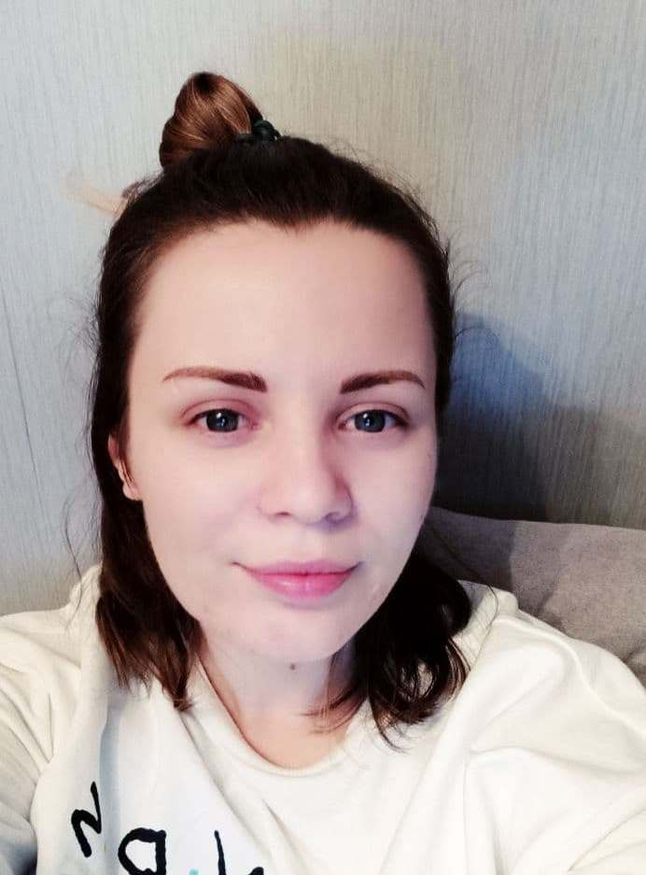
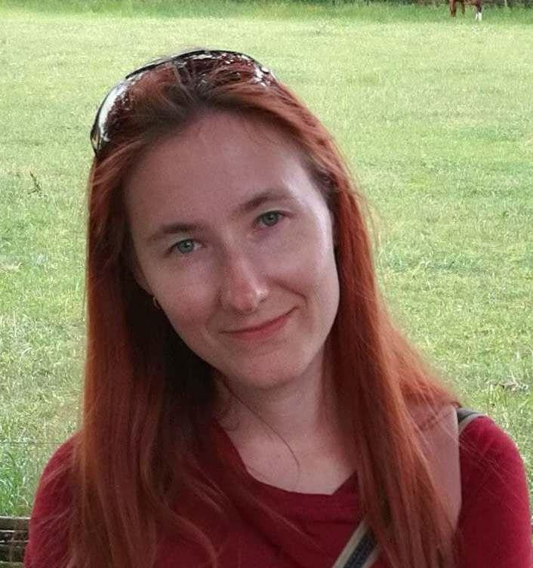
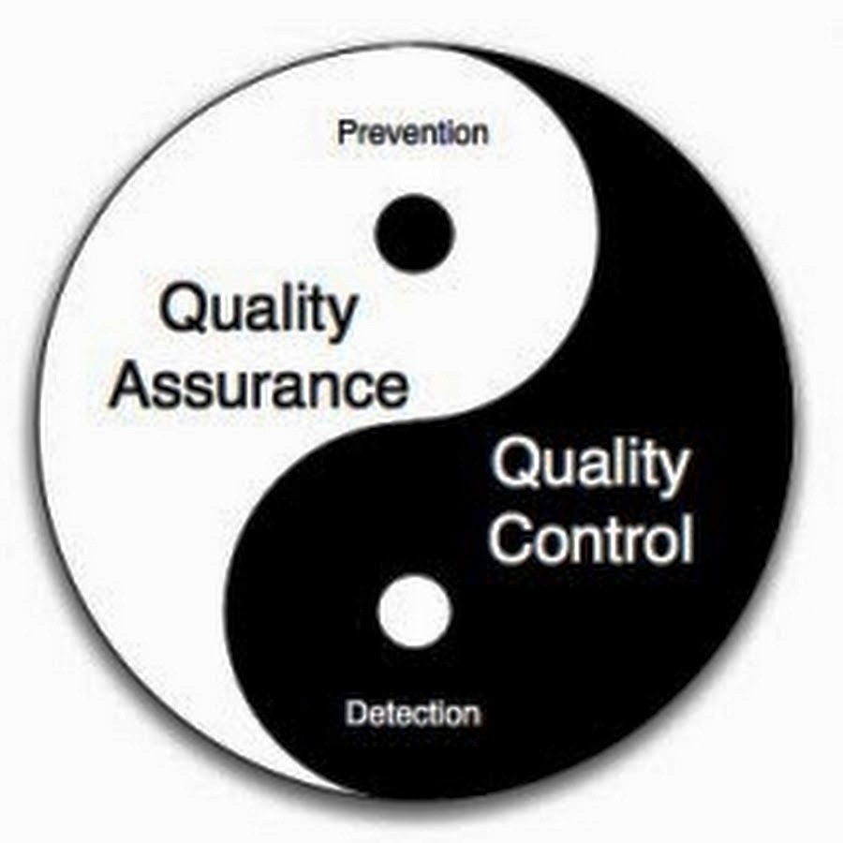
Resources
Alina Matsveyuk
Irina Lishchenko
our team two juniors QA Engineers
interaction 24/7
Software: Google Chrome version 27 and above (ver 91.0.4472.101)
Tools: Jira Software; Google Docs; Microsoft Office Excel 2007

Slide 6
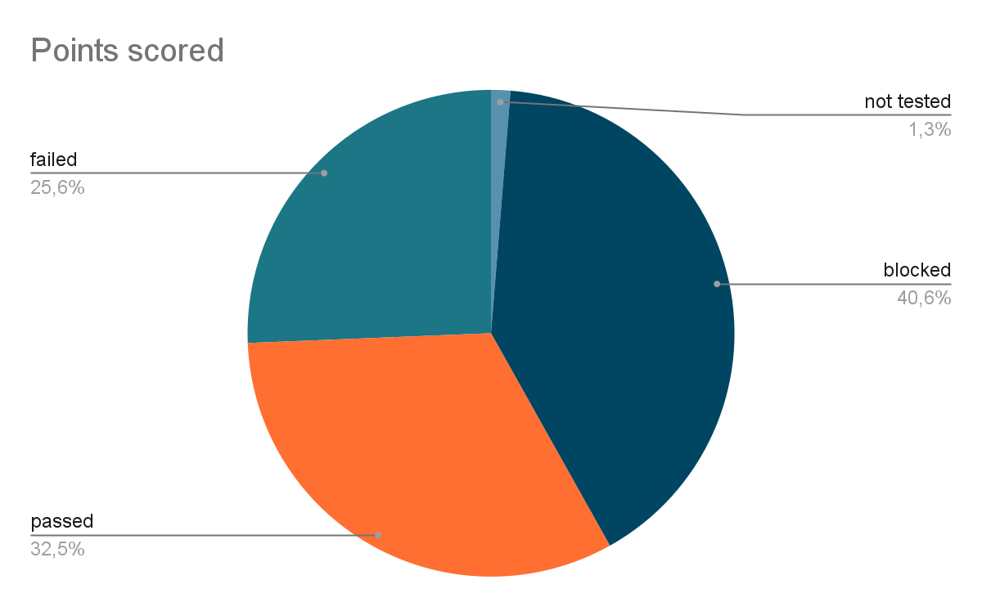
As a test documentation, the preparation of a checklist was chosen. For each application module, checkpoints were compiled for the interface and main functionality.
Total number - 234
not tested - 3
blocked - 95
passed - 76
failed - 60
Tests with the "not tested" status did not pass due to the lack of a description of these modules in the requirements. Tests with "locked" status failed due to disabled buttons.

Slide 7
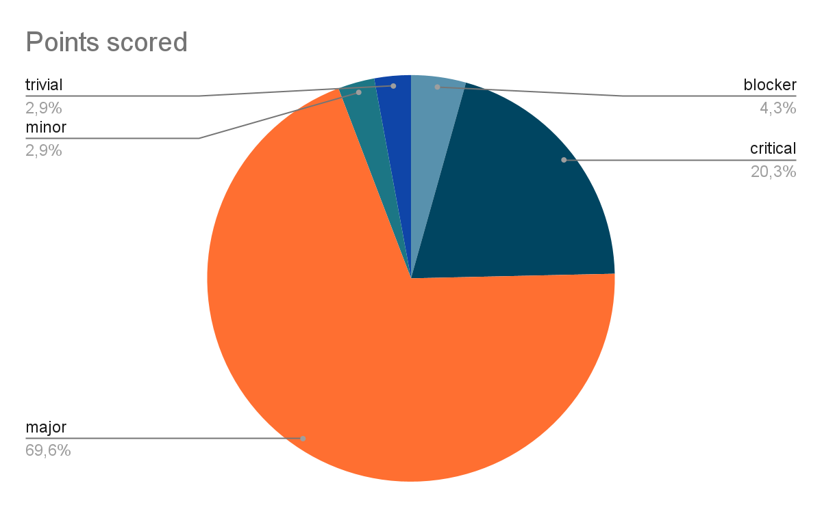

During the passing of the tests, bugs were fixed in Jira Software. Bugs were described with a summary of the defect, steps to reproduce it, actual and expected results, severity and priority.
Total amount - 69
blocker - 3
critical - 14
major - 48
minor - 2
trivial - 2

Slide 8

Conclusions and recommendations
Critical path testing was not completed in full due to the presence of critical bugs, so at the moment there is no way to release the application.
After the defects in the requirements are fixed and the development team fixes the errors, the main functionality will be re-tested according to the prepared checklist, and if all checkpoints are successfully passed, we can release a working version of the product.

Slide 9
